Slide 1

DENIAL OF SERVICE USING MYSQL RELATIONAL DATABASE STRUCTURE BASED ON NETWORK SECURITY
Prepared By: Guided By: Anuja Dixit Zakir Hussain

Slide 2
Table of content
What Is Dos
Types of Dos attack
Common Attack Techniques
Protection Against DoS
Project

Slide 3
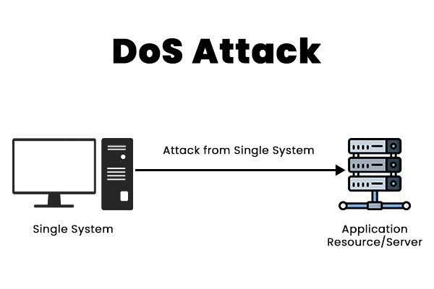
What is DoS
A Denial of Service (DoS) attack is a type of cyberattack where an attacker attempts to make a computer or network resource unavailable by overwhelming it with traffic or requests. The goal of a DoS attack is to exhaust the resource's capacity, making it unable to handle legitimate requests.

Slide 4
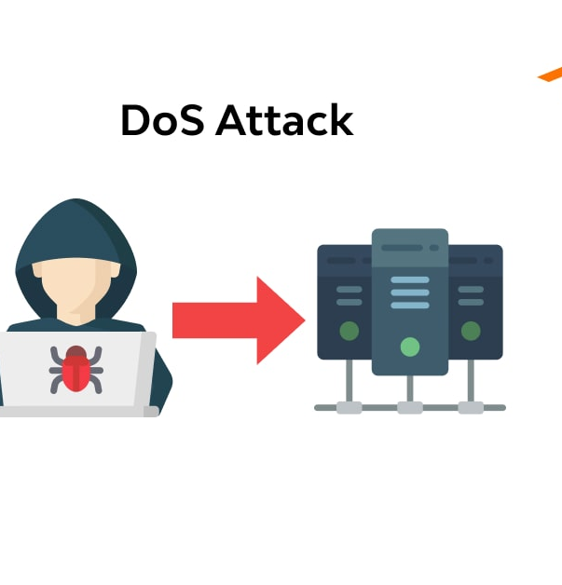
Types of DoS Attacks
Volume-Based Attacks: Volume-based attacks flood a network with too much data, overpowering its bandwidth and making the network unusable. Examples include UDP floods and ICMP floods.
Protocol Attacks :Protocol attacks exploit weaknesses in network protocols to use up server resources. Examples are SYN floods and the Ping of Death.
Application Layer Attacks: Application layer attacks target specific applications or services, causing them to crash or become very slow. Examples include HTTP floods and Slowloris.

Slide 5
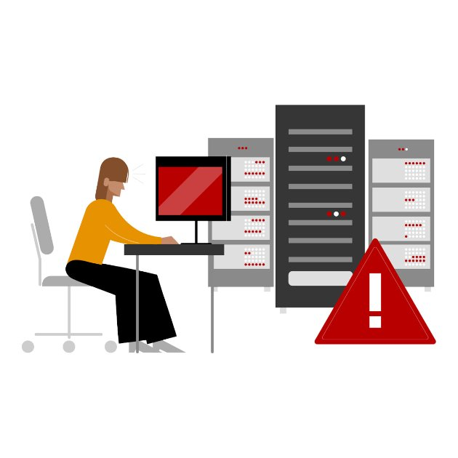
Types of DoS Attacks
Distributed Denial-of-Service (DDoS) Attacks: DDoS attacks use multiple systems, often compromised computers , to attack a single target. Examples are amplification attacks and botnet-based attacks.
Resource Exhaustion: This is when the hacker repeatedly requests access to a resource and eventually overloads the web application. The application slows down and finally crashes. In this case, the user is unable to get access to the webpage.
Reflective Attacks: Reflective attacks involve sending requests to third party servers with the victim’s IP address. The servers unknowingly send responses to the victim, overwhelming it. Examples are DNS reflection and NTP reflection.

Slide 6

Common Attack Techniques
Flooding: This technique involves sending an overwhelming amount of requests or traffic to a target system, such as a server or network. The goal is to overload the target's resources, such as CPU, memory, or bandwidth, making it impossible to respond to legitimate traffic. Example: UDP flood, ICMP flood (Ping flood), HTTP flood.
Buffer Overflow: Buffer overflow occurs when an attacker sends more data to a buffer (a temporary storage area in memory) than it can handle. This overflow causes the application to behave unexpectedly, often leading to crashes or even allowing the attacker to execute malicious code. Example: An attacker exploits a vulnerable program to cause a buffer overflow, crashing the system or running malicious code.

Slide 7
Common Attack Techniques
Malformed packets: In this technique, the attacker sends packets (units of data transmitted over a network) that contain incorrect or malicious data. These malformed packets can exploit vulnerabilities in network protocols, causing errors or crashes in the target system. Example: The Ping of Death attack, where oversized or fragmented ICMP packets are sent to crash the target.
SYN Flooding: SYN flooding is a type of TCP-based attack where an attacker sends a large number of SYN (synchronize) requests, initiating a TCP connection but never completing the handshake. The server allocates resources for each incomplete connection, quickly exhausting its capacity to handle new connections. Example: An attacker floods a web server with SYN requests, making it unavailable to legitimate users.

Slide 8
Protection Against DoS
Firewalls
Intrusion Detection/Prevention Systems (IDS/IPS)
Load Balancing
Content Delivery Networks (CDNs)
DDoS Mitigation Services

Slide 9
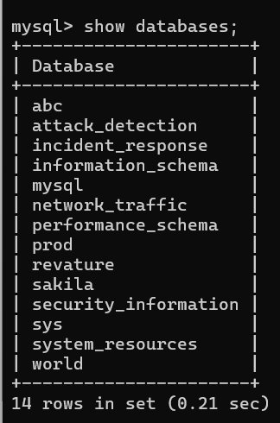
Project
This project involves 5 databases and 5 key tables in each, designed to detect, monitor, and respond to DoS attacks.
Attack_Detection Database :Detect and log DoS attacks in real-time.Tables : Attacks ,attack_types,Sources, detection_rules , alerts.
Network_Traffic Database: Monitor network activity to detect abnormal traffic.Tables :traffic, Protocols, ip_addresses ,network_devices, traffic_stats.
System_Resources Database:Monitor system resources under attack.Tables: resource_usage ,resources ,system_stats ,process_list , user_sessions

Slide 10
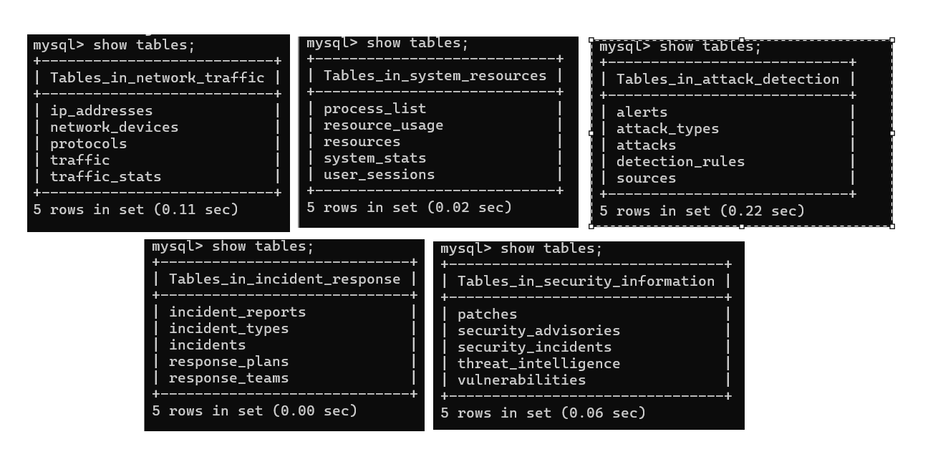
Projects
Incident_Response Database:Manage and track responses to DoS incidents.Tables : incidents, incident_types ,response_plans ,response_teams, incident_reports.
Security_Information Database :Track vulnerabilities, patches, and threats. Tables: Vulnerabilities,Patches,security_advisories,threat_intelligence,security_incidents.

Slide 11


